Slide 1

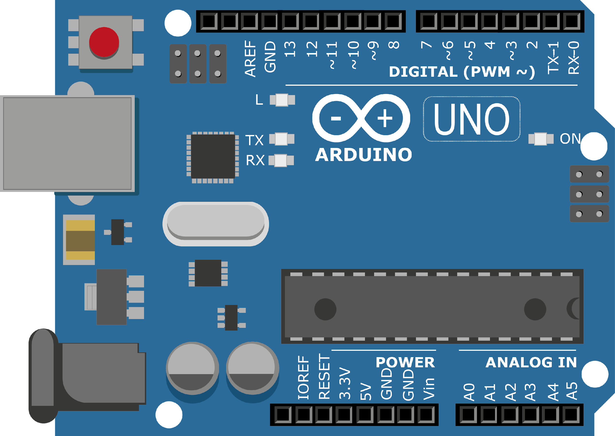
ARDUINO MASTER CLASS
08
Motion Detection using PIR & IR Sensor

Slide 2
8 AGENDA
02
03
01
Infrared
Motion detection system
Q & A

Slide 3
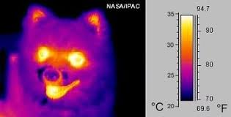
InfraRed
Infrared radiation (IR), or infrared light, is a type of radiant energy that's invisible to human eyes but that we can feel as heat.
All objects in the universe emit some level of IR radiation, but two of the most obvious sources are the sun and fire.

Slide 4
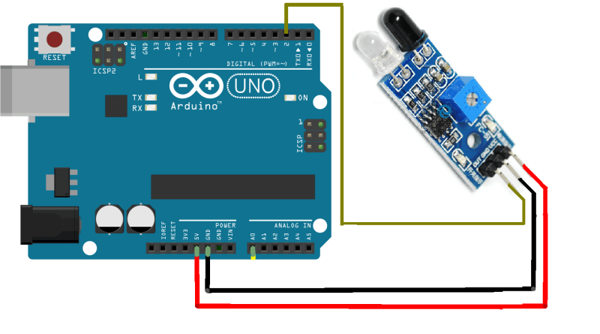
IR Sensor with Arduino

Slide 5
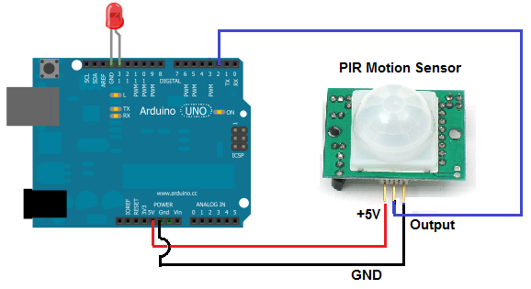
PIR Sensor with Arduino

Slide 6

INTERVIEW QUESTIONS
Clock frequency of Arduino
What is the default bootloader of the Arduino UNO?
How do you detect infrared?
16 MHz, which is 16,000,000 Hertz. That means there are 16 Million clock cycles per second
The optiboot bootloader will take 512 bytes, leaving 32256 bytes for application code. Due to its small size larger up-loadable sketch size is achieved.

Slide 7

THANKS!

